Slide 1
A Cost-sensitive model for preemptive intrusion response systems
By: Jordan Donovan

Slide 2
Introduction
Increase in cyber attacks has lead to an uptick in research
Intrusion detection is receiving much attention
Intrusion response is due more
Driving Problem:
Automatic intrusion response is needed, but still needs flexibility due to predefined responses and lack of cost consideration
Defining costs and risk factors is one of the challenges
Timeliness should be considered
Adaptation of response mappings

Slide 3
Introduction Cont.
Solution Presented
Intrusion Response Model
Automated
Cost-Sensitive
Pre-emptive
Adaptive
Relies on existing pattern-based IDSs
Associate response actions based on IDS intrusion matching behavior and pre-specified threshold
Calculates the correct response, considering costs and benefits of all applicable responses and previously deployed response effectiveness to do so
Employs the response and records effectiveness

Slide 4
Introduction Cont.
Contributions
Preemptive deployment determination
Cost-sensitive methodology to response selection
Structured and comprehensive approach to automatic, preemptive, cost-sensitive, and adaptable response

Slide 5
Related Work
Most IRS research relies on a set of pre-determined set of actions. Some propose cost-sensitive approaches
Some cost-sensitive approaches considers costs and benefits of response actions with respect to system inter-dependencies
ADEPTS
Graphs attacks to show possible attack targets and responses
Static graph that requires semi-manual updating whereas the method presented uses dynamic, automatic updating
Uses response effectiveness and disruptiveness versus this method that uses intrusion damage cost and response cost along with utility theory

Slide 6
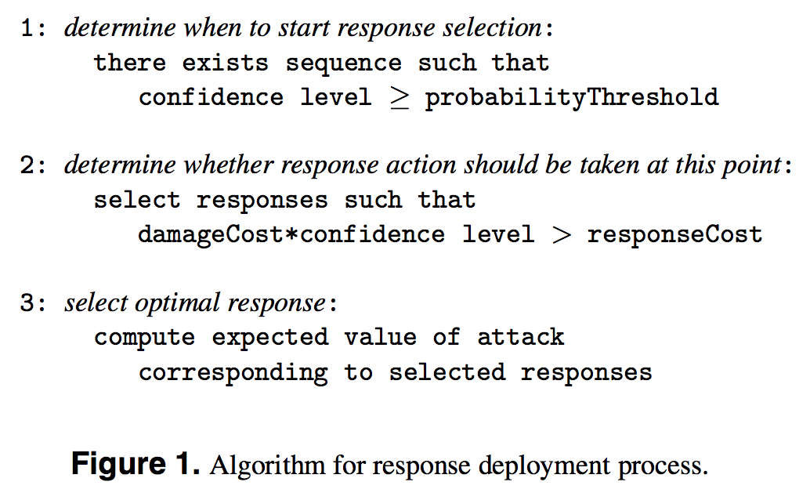
Intrusion Response Model
Associate response with each known attack
Notes:
Goal of step one is to determine when preemption should be deployed
Goal of step two is to identify the set of candidate responses that will result in less harm than the possible intrusion
Goal of step three is to deploy the response with the highest possible chance of blocking the intrusion

Slide 7
Intrusion Response Model Cont.
Preemption
Should be used when confidence of attack is above a certain threshold.
Confidence:
# of sequence occurrences / total # of Sequences with this prefix
Cost-Sensitive Selection of Possible Responses
Decide on the possible responses once we have reached the threshold for responding to an intrusion
Available Responses must satisfy the following
Damage Cost * Confidence Level > Response Cost
Cost-Sensitive Response Invocation
Determine optimal response from step 2 using Success Factor and Risk Factor
If the response fails, then repeat process
Flexibility based on utility theory where Risk Factors can be adjusted for each specific use case

Slide 8
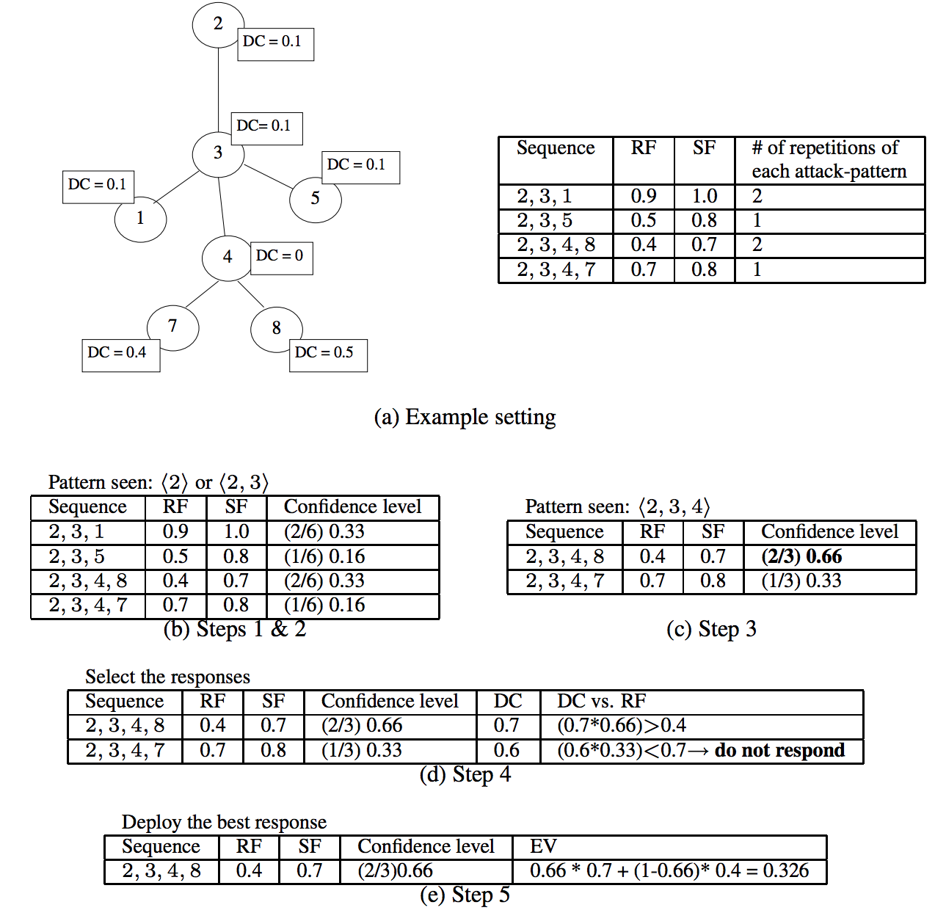
Intrusion Response Model Cont.
Adaptability
Changes in accordance to the responses previously deployed by the system
If successful, increase Success Factor
If unsuccessful, decrease Success Factor
Illustrative Example

Slide 9
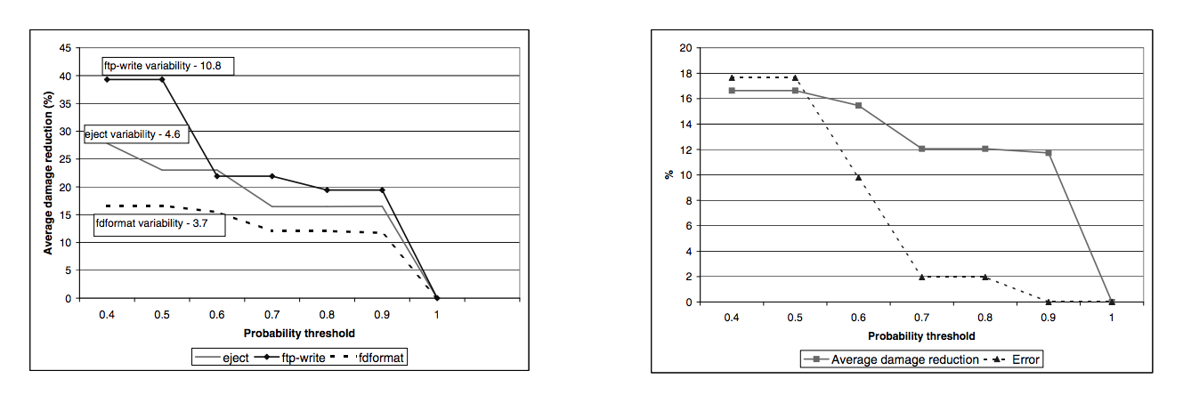
Experiments
Data – Basic Security Model audit records
Results
Errors
Early Response Error – Low threshold may force preemptive response before distinguishing pattern has emerged.
Never-seen-before – novel patterns should be handled by IDS

Slide 10
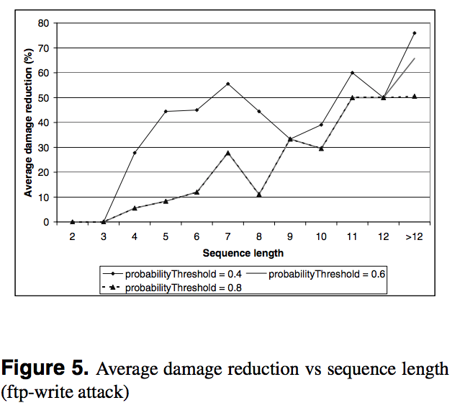
Experiments Cont.
Low threshold leads to higher damage reduction
High threshold leads to lower damage reduction

Slide 11
Conclusion
This approach to cost-sensitive modeling of responses to intrusions allows preemptive deployment of response and timely adjustment to the changing environment. Through the experiment, the paper demonstrates relationships between probability threshold, damage reduction, and error values. This allows for a system to select an optimal association of damage reduction and tolerable error

